Slide 1
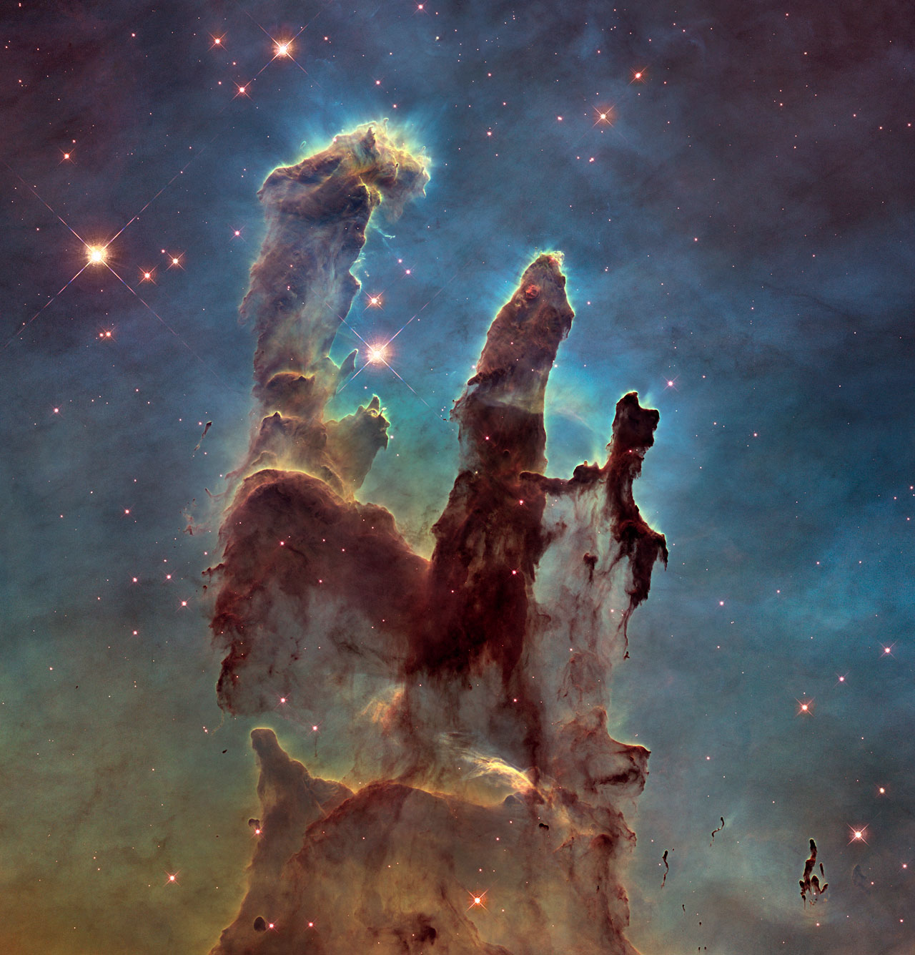
Neutrino Renaissance Xinchun Tian Oct. 15, 2015
Eagle Nebula’s Pillars of Creation, HUBBLE SPACE TELESCOPE

Slide 2
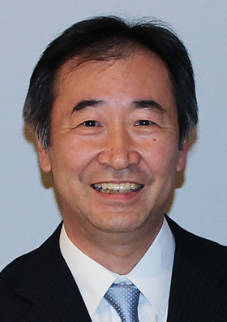
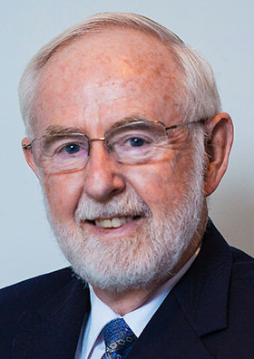
Quiz
“A far-reaching conclusion of the experiments is that the neutrinos, for a long time considered to be massless, must have a mass. This is of ground-breaking importance for particle physics and for our understanding of the universe.”
https://www.nobelprize.org
Q1: What is the 2015 Physics Nobel Prize about?
Takaaki Kajita
Arthur B. McDonald
A: “for the discovery of neutrino oscillations, which shows that neutrino have mass”

Slide 3
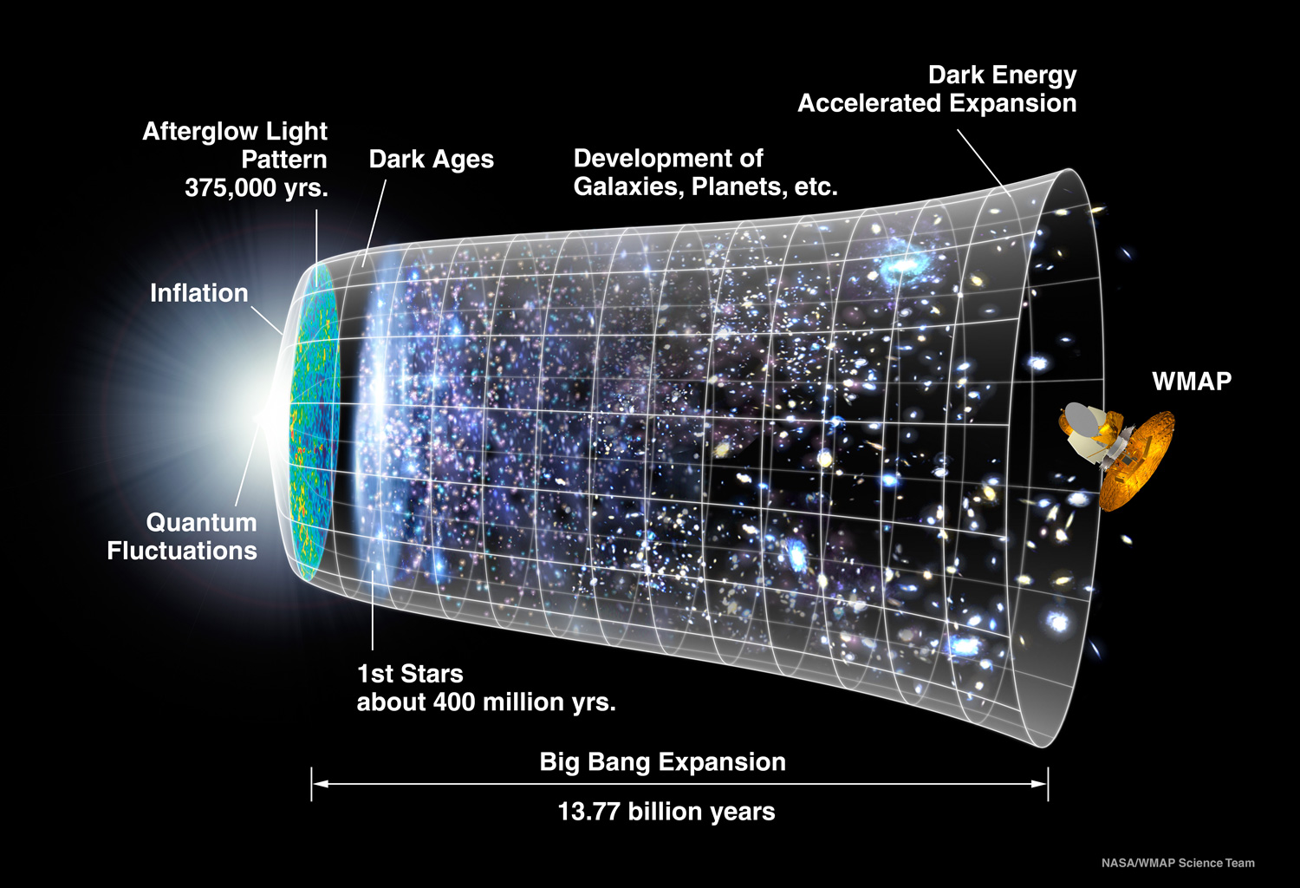
The Question: Matter-Antimatter Asymmetry Mystery
Big Bang Theory

Slide 4
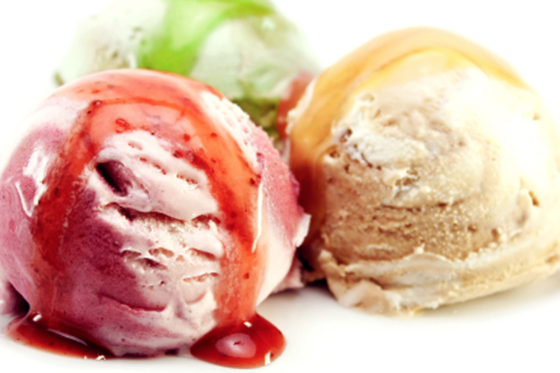

The Probe : Neutrino Oscillations
There are 3 neutrino species (flavors): ν_{e}, ν_{μ}, ν_{τ}
They can oscillate from one to another
The first evidence was announced in 1998 from Super-Kamiokande, Japan, led by Takaaki Kajita and In 2001 from SNO (Sudbury Neutrino Observatory), Canada, led by Arthur B. McDonald
ν_{τ}
ν_{μ}
ν_{e}

Slide 5
The Question :
matter-anti-matter asymmetry mystery
The Probe:
Neutrino Oscillation
The Tool:
Neutrino Experiments

Slide 6
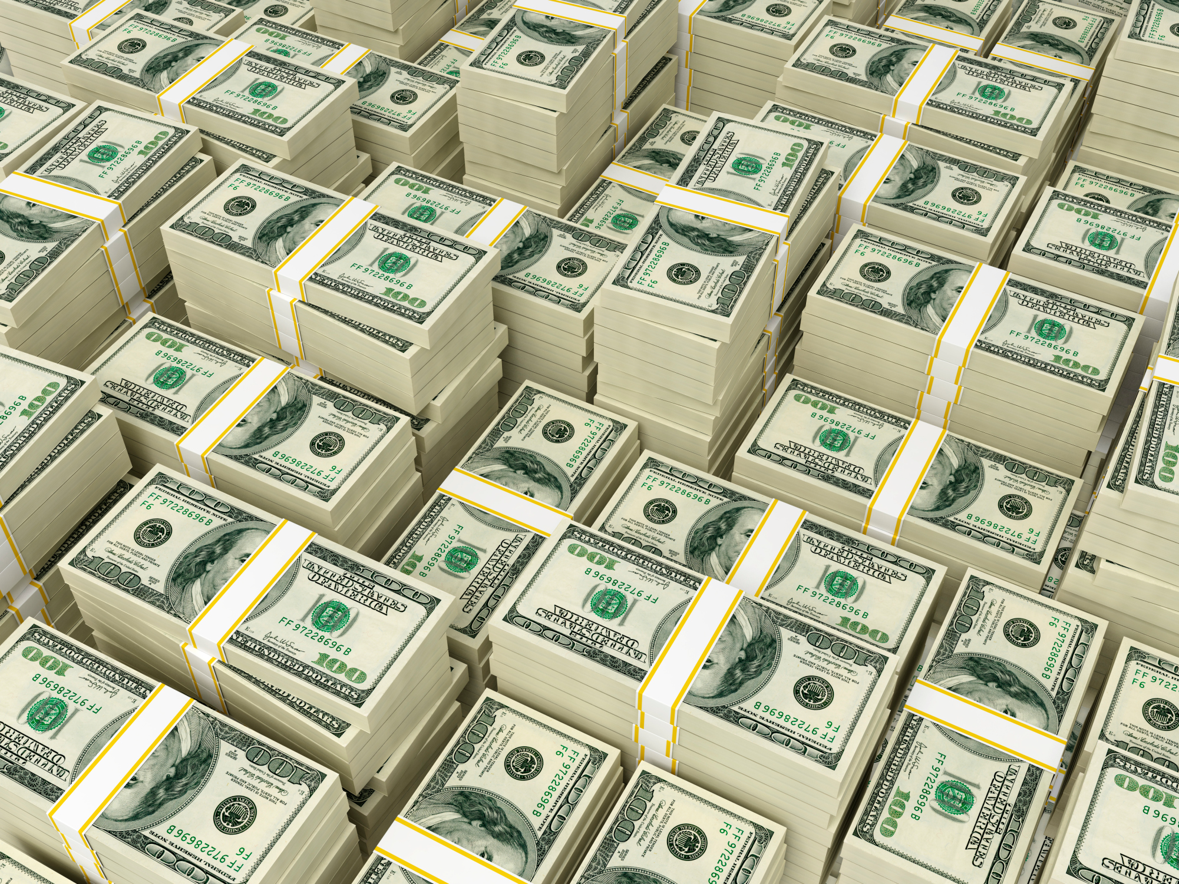
The Tool: Neutrino Experiments
Customers
Financial Institutions
Quantitative Finance Analyst
Interact
Transaction
Data
Neutrino Sources
Neutrino Detectors
Scientists
Interact
Physics
Data

Slide 7
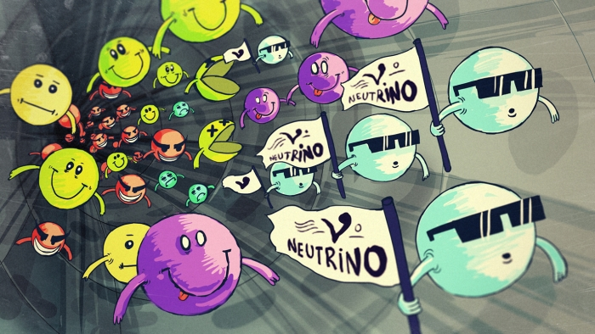
Neutrino Experiments
Neutrino Sources
Neutrino Sources
Neutrino Detectors
Data Analysis

Slide 8
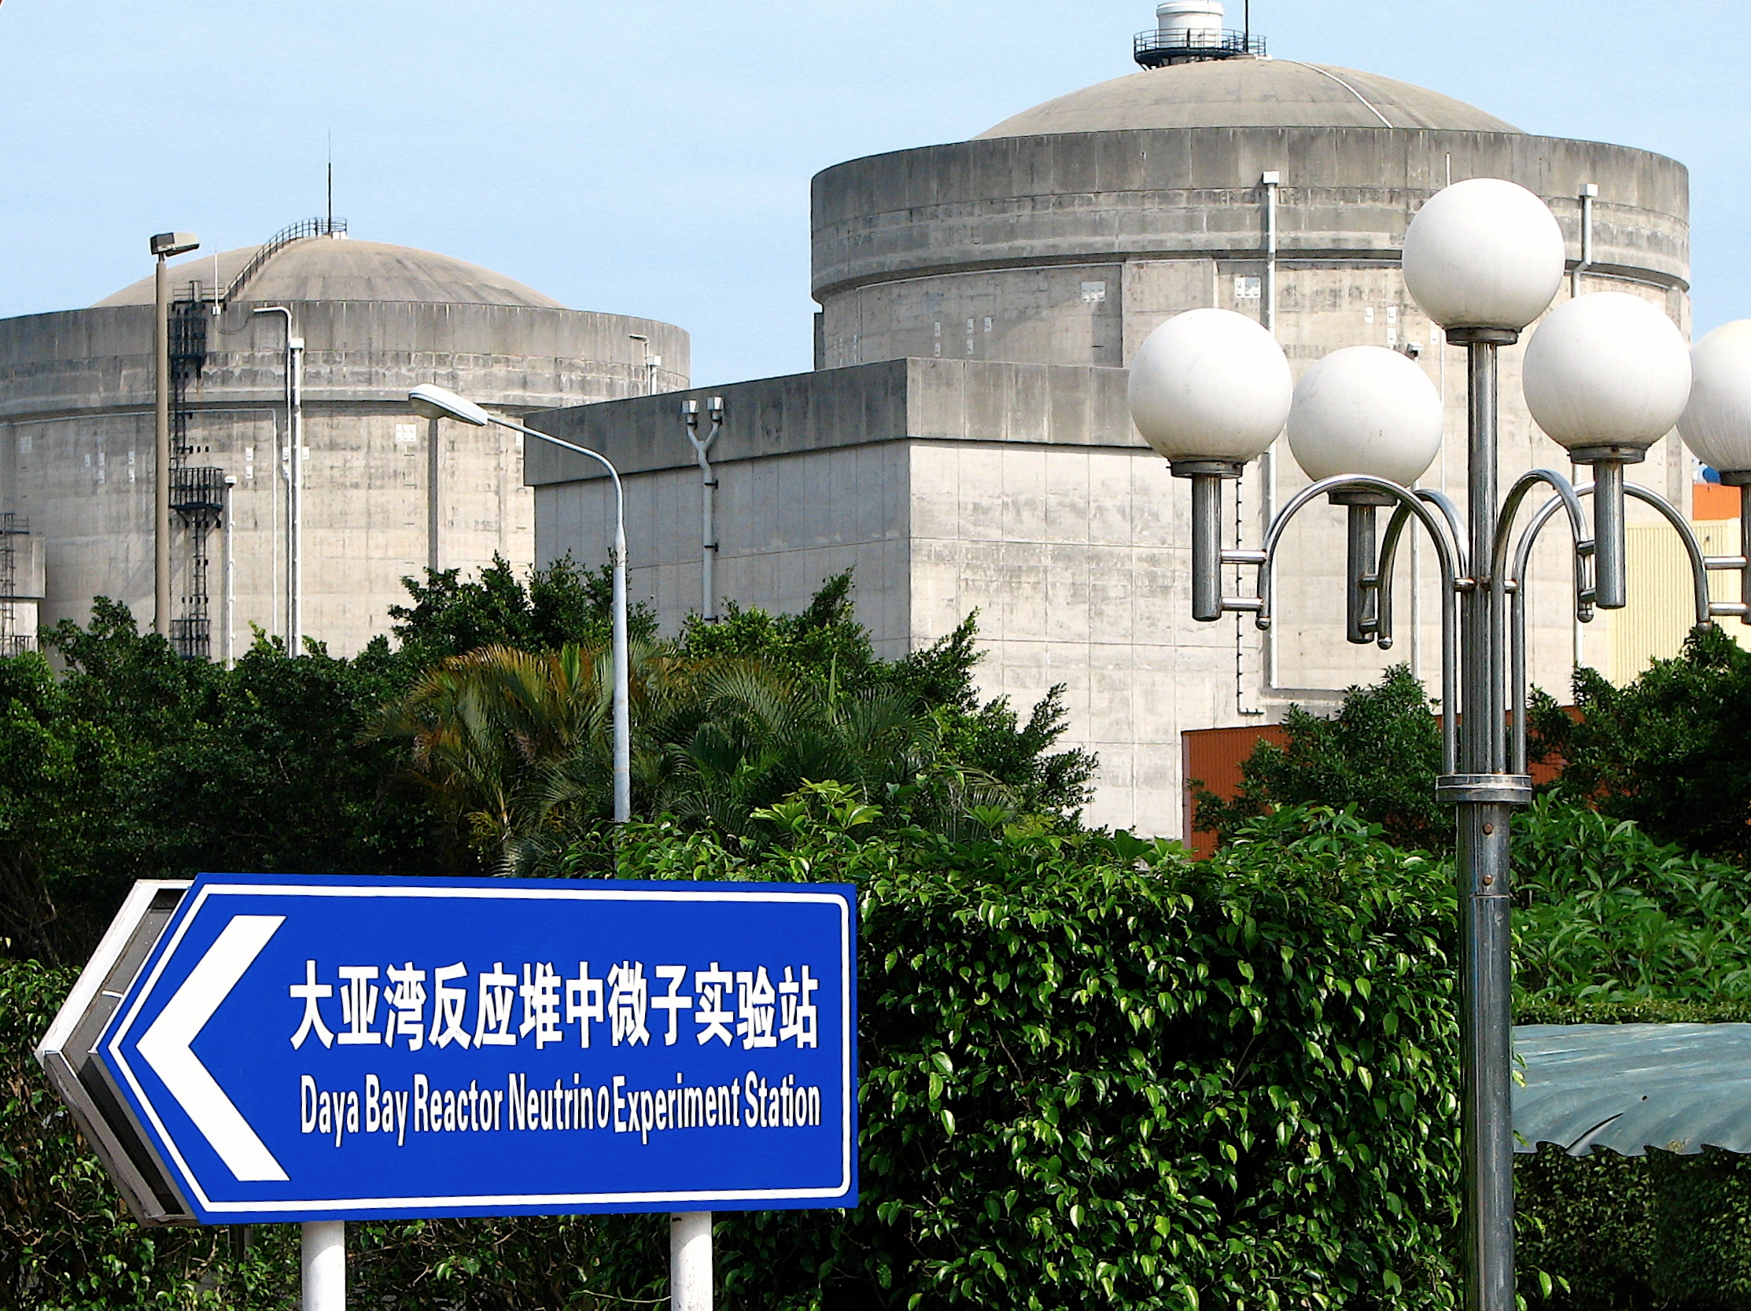
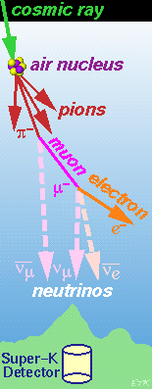
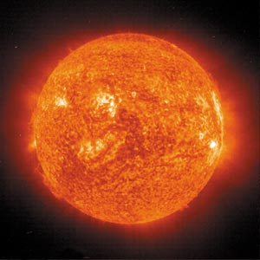
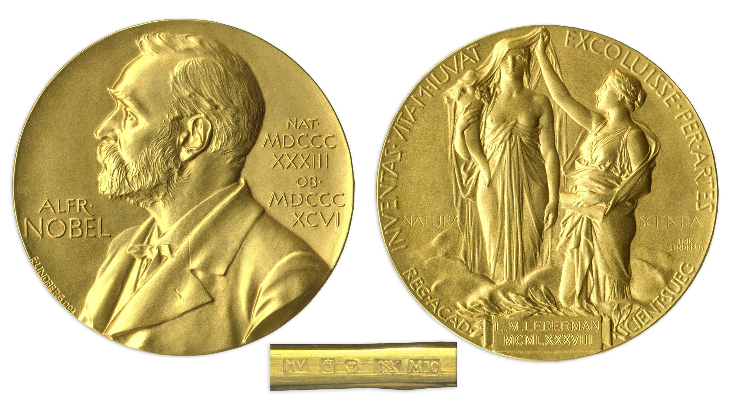
Neutrino Sources
Reactor neutrinos
Solar neutrinos
Atmospheric neutrinos
2015 Physics

Slide 9
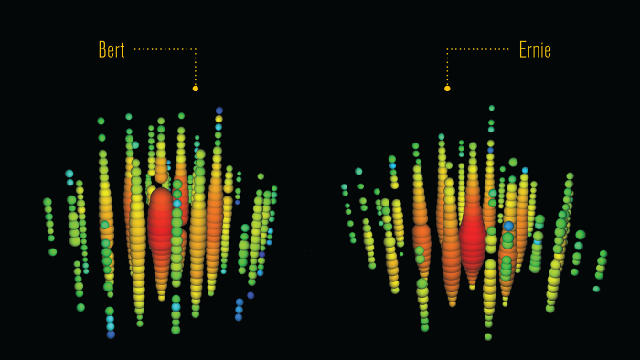
Neutrino Experiments
Neutrino Detectors
Neutrino Sources
Neutrino Detectors
Data Analysis

Slide 10
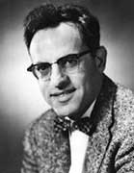
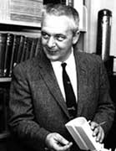
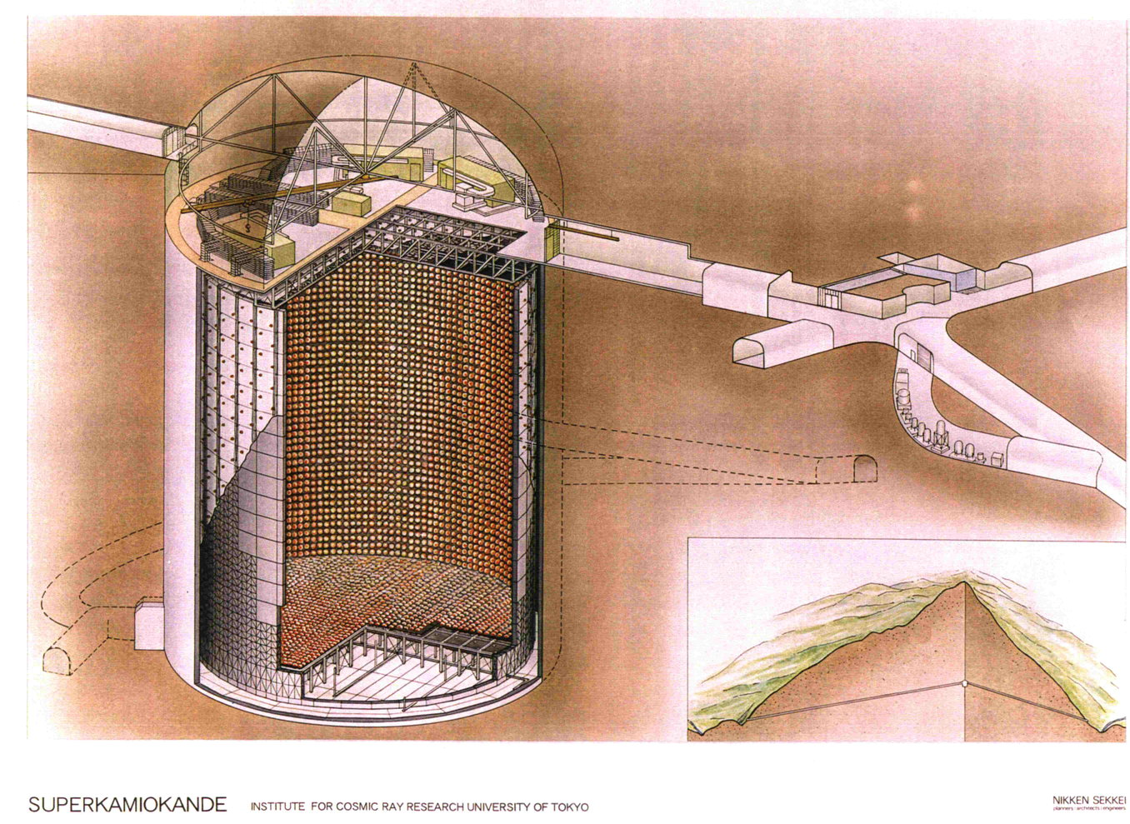
Neutrino Detectors
200 liters of water with ~ 40 kg of cadmium chloride (CDCl₂)
1956, Frederick Reines and Clyde L. Cowan, Jr. discovered the electron neutrino, Savannah River Plant, Aiken, SC
1995 Nobel Prize
50,000 tons of ultra-pure water
2015, Takaaki Kajita and Arthur B. McDonald, won Nobel Prize for discovery of Neutrino Oscillations

Slide 11
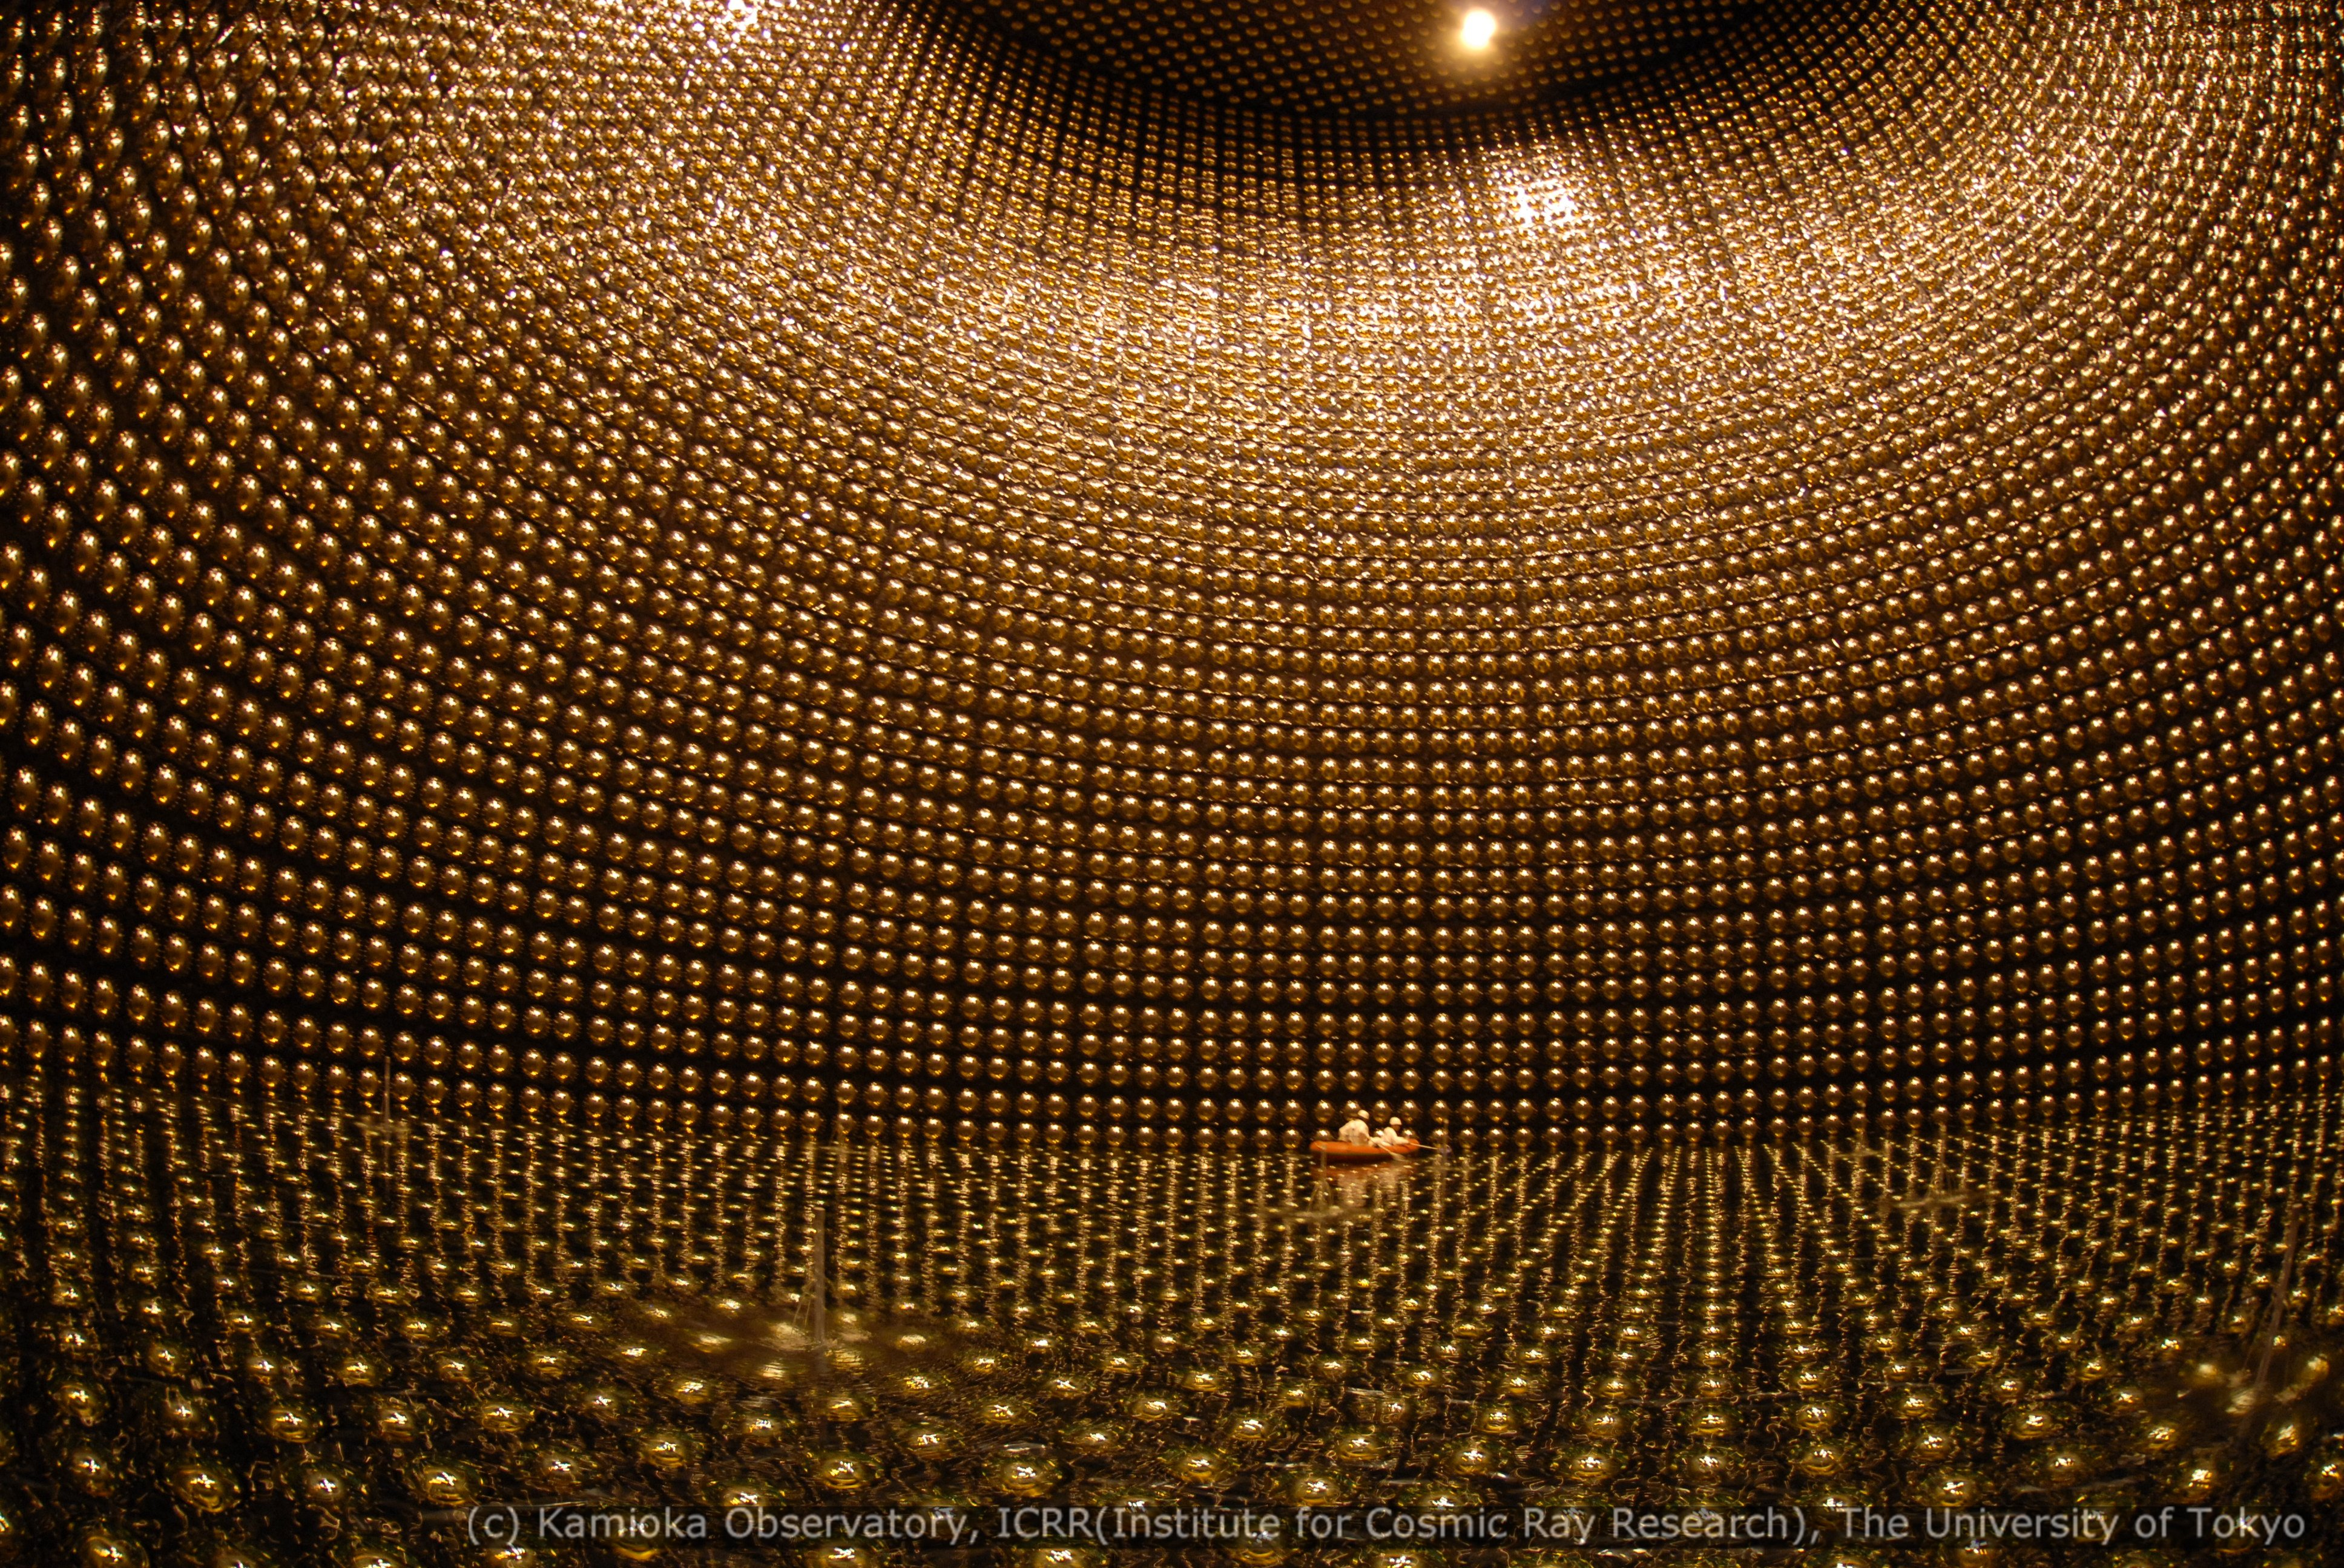
Super-kamiokande detector (50,000 tons of ultra pure water)

Slide 12

Neutrino Experiments
Data Analysis
Neutrino Sources
Neutrino Detectors
Data Analysis

Slide 13
2. Exploratory Data Analysis & Data Selection
1. Data Cleaning / Data Quality
Monte Carlo &
Visualization
3. Machine Learning / Logistic Regression
4. Statistical Inference

Slide 14
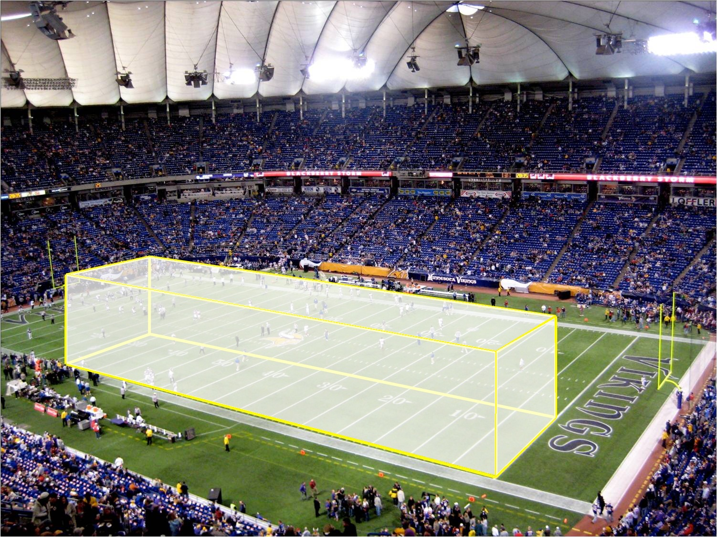
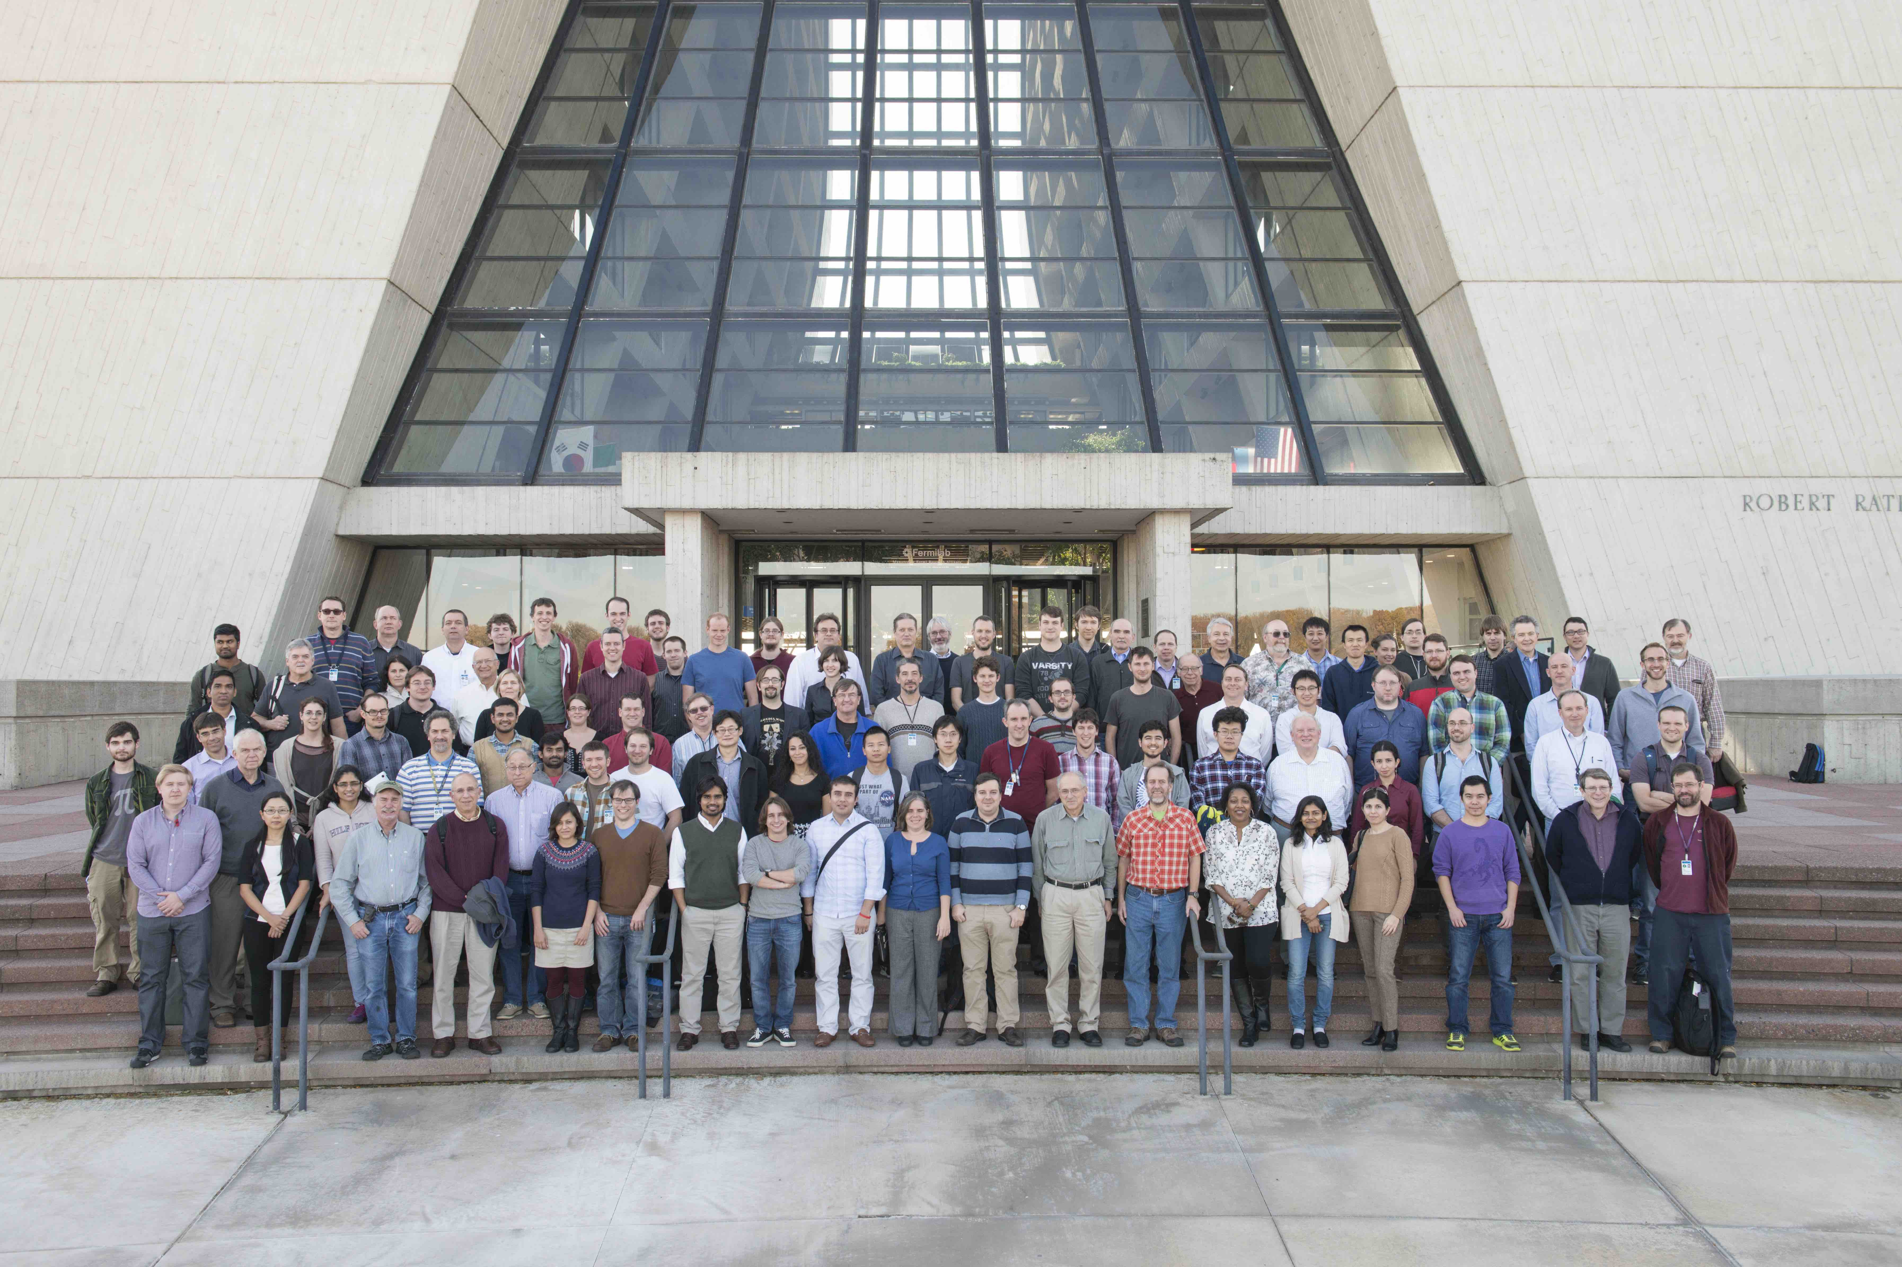
NOνA Experiment
844,363,840 records
210 collaborators from 39 institutions, 7 countries

Slide 15
Data Cleaning / Data Quality
In some cases, the neutrino beam or neutrino detector
do not work properly, therefore the data collected have
poor quality.
In general, remove the bad data with some data quality
selection, instead of impute or correct them.

Slide 16
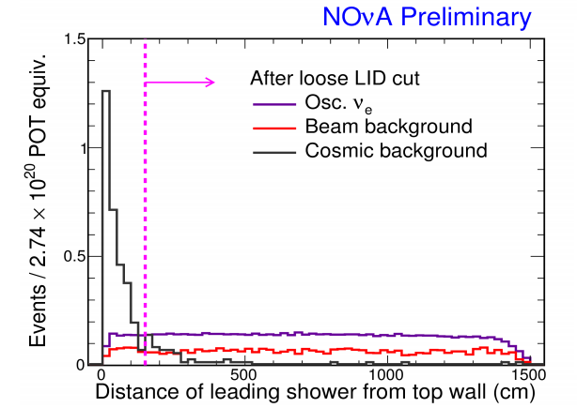
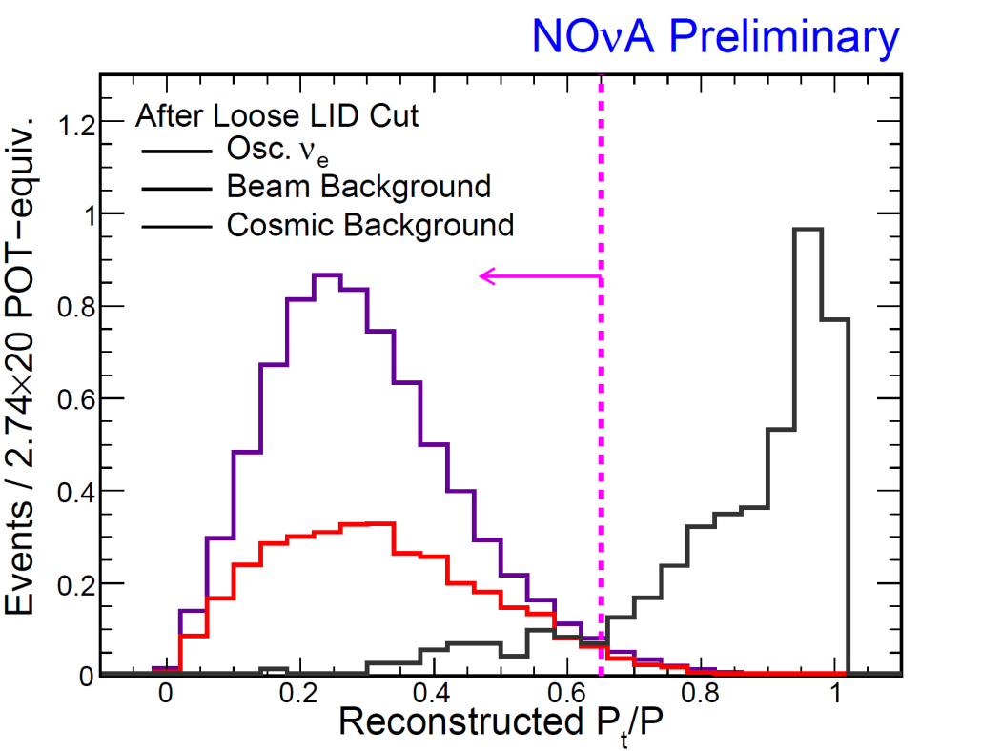
Exploratory Data Analysis & Data Selection
Must understand the characteristics of each variables/distributions
Must understand the neutrino source, neutrino detector, and physics
There is always Data-Monte Carlo inconsistency, which has to be
understood and MC simulation has to be improved
The EDA will find some good variables to apply some selection criteria to
reject the noise but keep the signal as much as possible.
Tons of studies/plots/tables involving many, many FTEs

Slide 17
Machine Learning Analysis – Neural Network
16 variables are used in the Neural Network analysis, which
are based on: physics intuition, exploratory data analysis, and
separation power (ranking)

Slide 18
Machine Learning Analysis – Neural Network
16 variables are used in the Neural Network analysis,
which are based on: physics intuition, exploratory data
analysis, and separation power
Accuracy is above 80%
Experimental Data
MC simulation

Slide 19
Machine Learning Analysis – Library Event Matching
Compare an unknown trial event to a library of known events
Properties of best-matched known events are used to
classify trial event
Accuracy is above 80%
MC simulation
Experimental Data

Slide 20
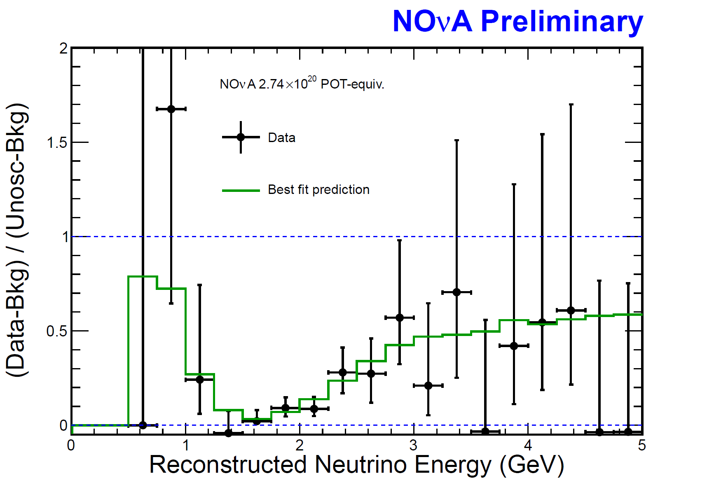
Statistical Inference
33 events selected
Χ²=12.64/16 dof

Slide 21
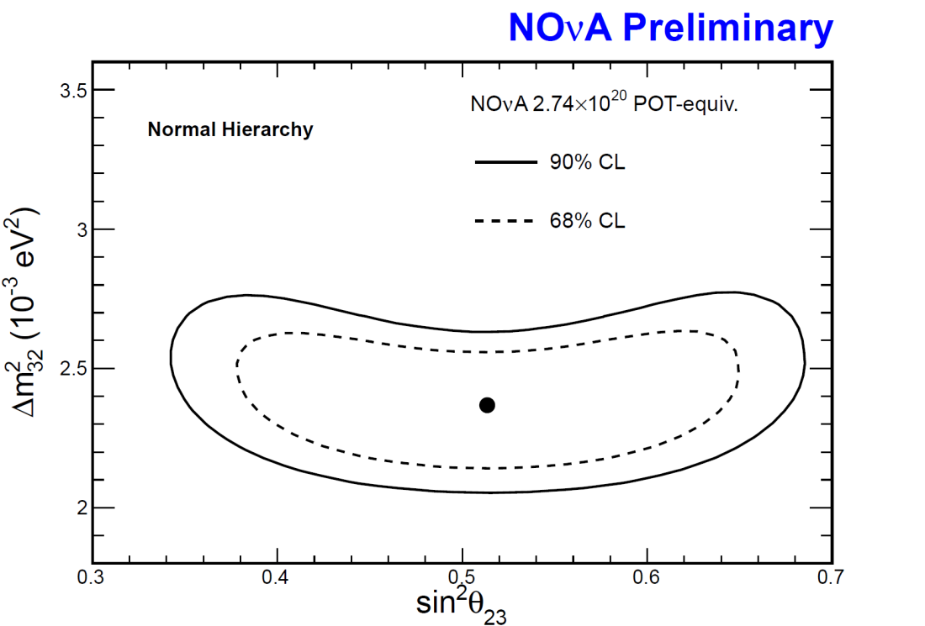
Statistical Inference
6.5% measurement uncertainty
Will collect ×12 more statistics to improve the precision

Slide 22
Hint, Evidence and Discovery
P-value | σ (standard deviation)
0.3173 | 1 | Hint
4.55×10⁻² | 2 | Hint
2.7×10⁻³ | 3 | Evidence
6.3×10⁻⁵ | 4 | Evidence
5.7×10⁻⁷ | 5 | Discovery

Slide 23
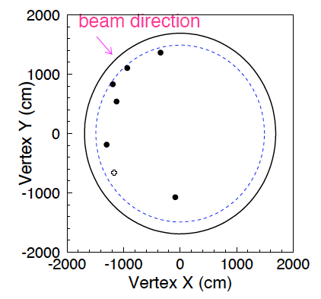
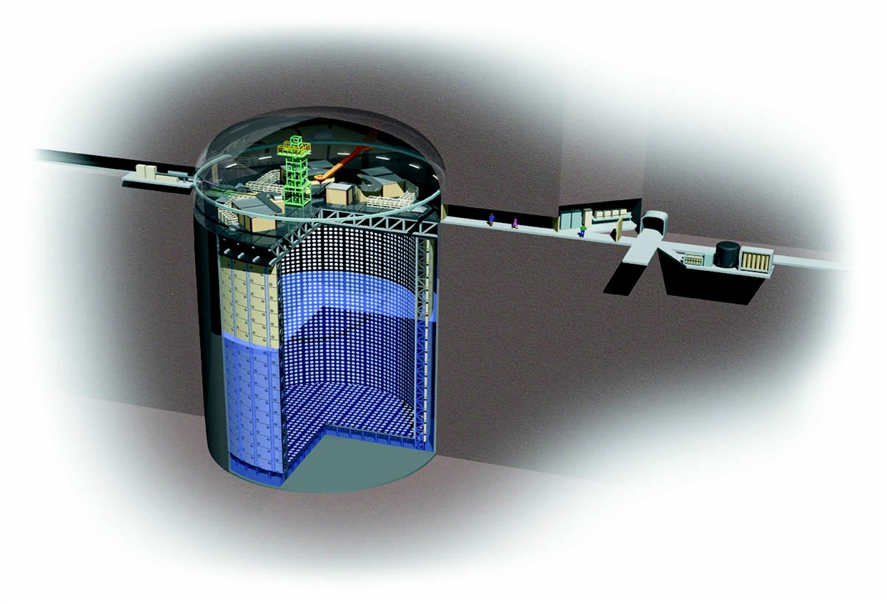
Monte Carlo Simulation
Monte Carlo simulation is used across the entire experiment, from experiment design, to statistical data analysis
Experiment design
Estimate the experiment parameters and physics reaches before
conducting the experiment which is similar to “determine the sample size”
Hypothesis test
In 2012, T2K experiment published
their results with 6 observed events.
What is the probability of observing
all 6 events close to the edge?
Monte Carlo simulation tells us : 3%

Slide 24
Find needle in a haystack
844,363,840
33
6.5% uncertainty in preliminary result
If we assume it is a very rainy day in the large city of Houston, it would be like someone asking you to look at all of those clear rain drops and find one drop that is colored red! As we look at billions of data points, we are seeking a drop in a rainstorm of information^{[1]}.
Samuel Ting, 1976 Nobel Prize
[1] https://blogs.nasa.gov/ISS_Science_Blog/2014/08/21/ams-amassing-answers-to-the-questions-of-the-universe/

Slide 25
Conclusion

Slide 26


Slide 27
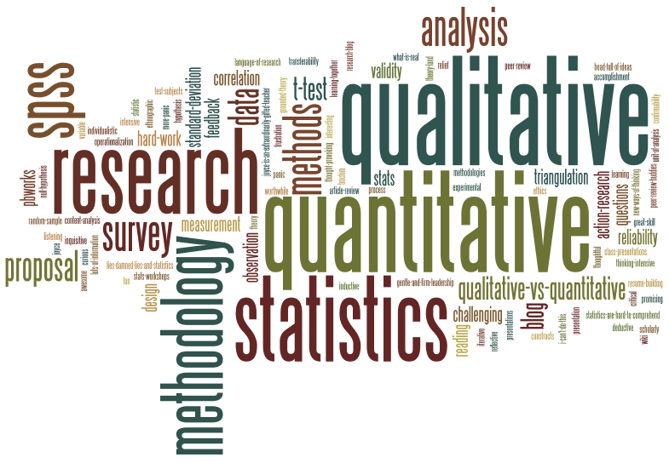
The Tool: Neutrino Experiments
Customers
Financial Institutions
Quantitative Finance Analyst
Interact
Transaction
Data
Neutrino Sources
Neutrino Detectors
Scientists
Interact
Physics
Data

Slide 28
Backups

Slide 29
Quiz
“Without neutrinos, the sun wouldn’t shine and we wouldn’t have elements heavier than hydrogen.”
The Symmetry Magazine
Q1: What is the second most abundant particle in universe?
A: Neutrinos (after photons)
1.2×10⁸⁹ neutrinos in the universe, comparing to $84.9 trillion (~10¹⁴) net worth of the U.S. households and nonprofit organizations in 2015^{[1]}.
330 neutrinos per cm³
100 trillion neutrinos passing through us every second. Neutrino interacts very weakly - ghost particle.
[1] American’s Net Worth Reaches High of $84.9 Trillion, The Wall Street Journal

Slide 30
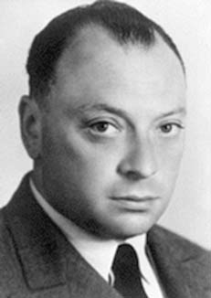


Neutrino- The Ghost Particle
100 trillion neutrinos passing through us
every second
Neutrino interacts very weakly
1930, Wolfgang Pauli proposed the existence
The interaction length of a high energy
neutrino is about 2.5 million kilometers of
water. If we want to detect neutrinos, we need:
Lots, lots of neutrinos
Large detectors
Natural radioactivity of the potassium in banana

Slide 31
Neutrino Sources
Rev. of Mod. Phys. 84, 1307 (2002)
Natural Sources
Manmade Sources

Slide 32
Neutrino Detectors
1930, Wolfgang Pauli proposed the existence, 1945 Nobel Prize on Pauli Principle
200 liters of water with ~ 40 kg of cadmium chloride (CDCl₂)
1956, Frederick Reines and Clyde L. Cowan, Jr. discovered the electron neutrino, Savannah River Plant, Aiken, SC
1995 Nobel Prize

Slide 33
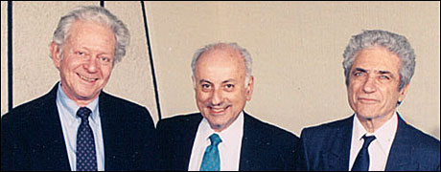
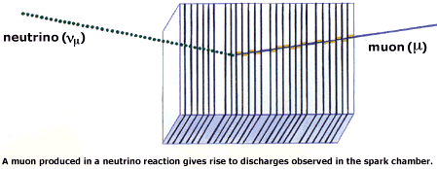
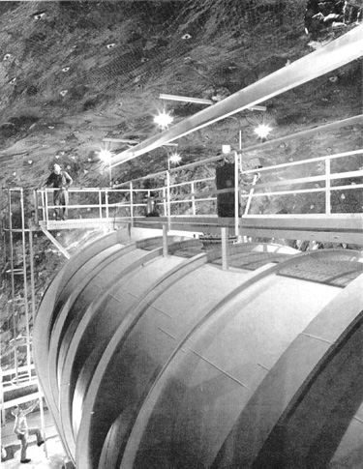
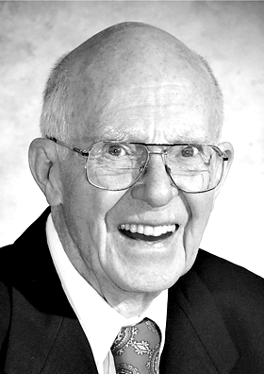
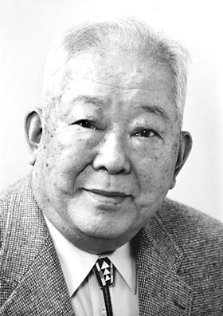
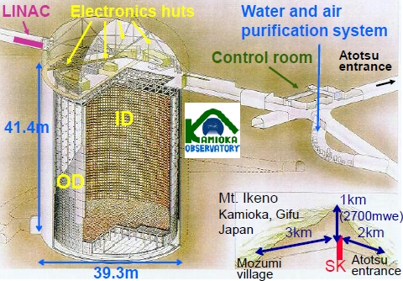
Neutrino Detectors
1962, Leon M. Lederman, Melvin Schwartz and Jack Steinberger discovered the muon neutrino, BNL.
1998 Nobel Prize
5000-ton steel wall made of old battleship plates
100,000 gallons of a common dry-cleaning liquid
2002, Raymond Davis, and Masatoshi Koshiba won Nobel Prize for detection of cosmic neutrinos
50,000 tons of ultra-pure water

Slide 34
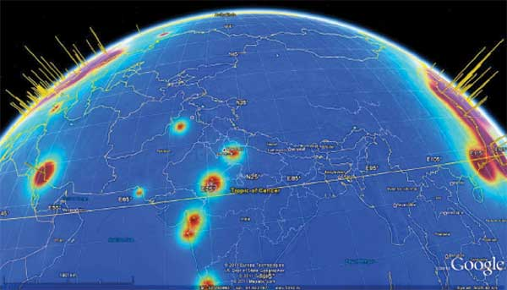
Application

Slide 35
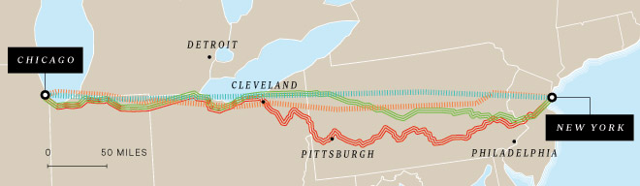
Faster Global Communications / Nuclear Submarines
High frequency Trading
http://arxiv.org/abs/1203.2847, led by Daniel Stancil at NC State
Notes:
NY and Chicago, America’s two great trading centers, are 720 miles apart as the photon flies – about 3.9 milliseconds at the spend of light. But variations in transmission technology or how long the route is can make millions of dollars’ worth of difference to high frequency traders. – Katie M. Palmer

Slide 36


Monitor Nuclear Proliferation / National Security
WATCHMAN, Cleveland, Ohio
WATCHMAN (WATer CHerenkov Monitor of AntiNeutrinos) funded by DOE + NNSA, is a prototype neutrino detector that can monitor whether a nuclear reactor 400 km away is enriching the raw material for nuclear weapons.

Slide 37

Hello!
I am Xinchun Tian
I am here not because I love to talk about neutrinos, but because you are science geeks.

Slide 38

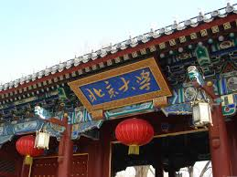
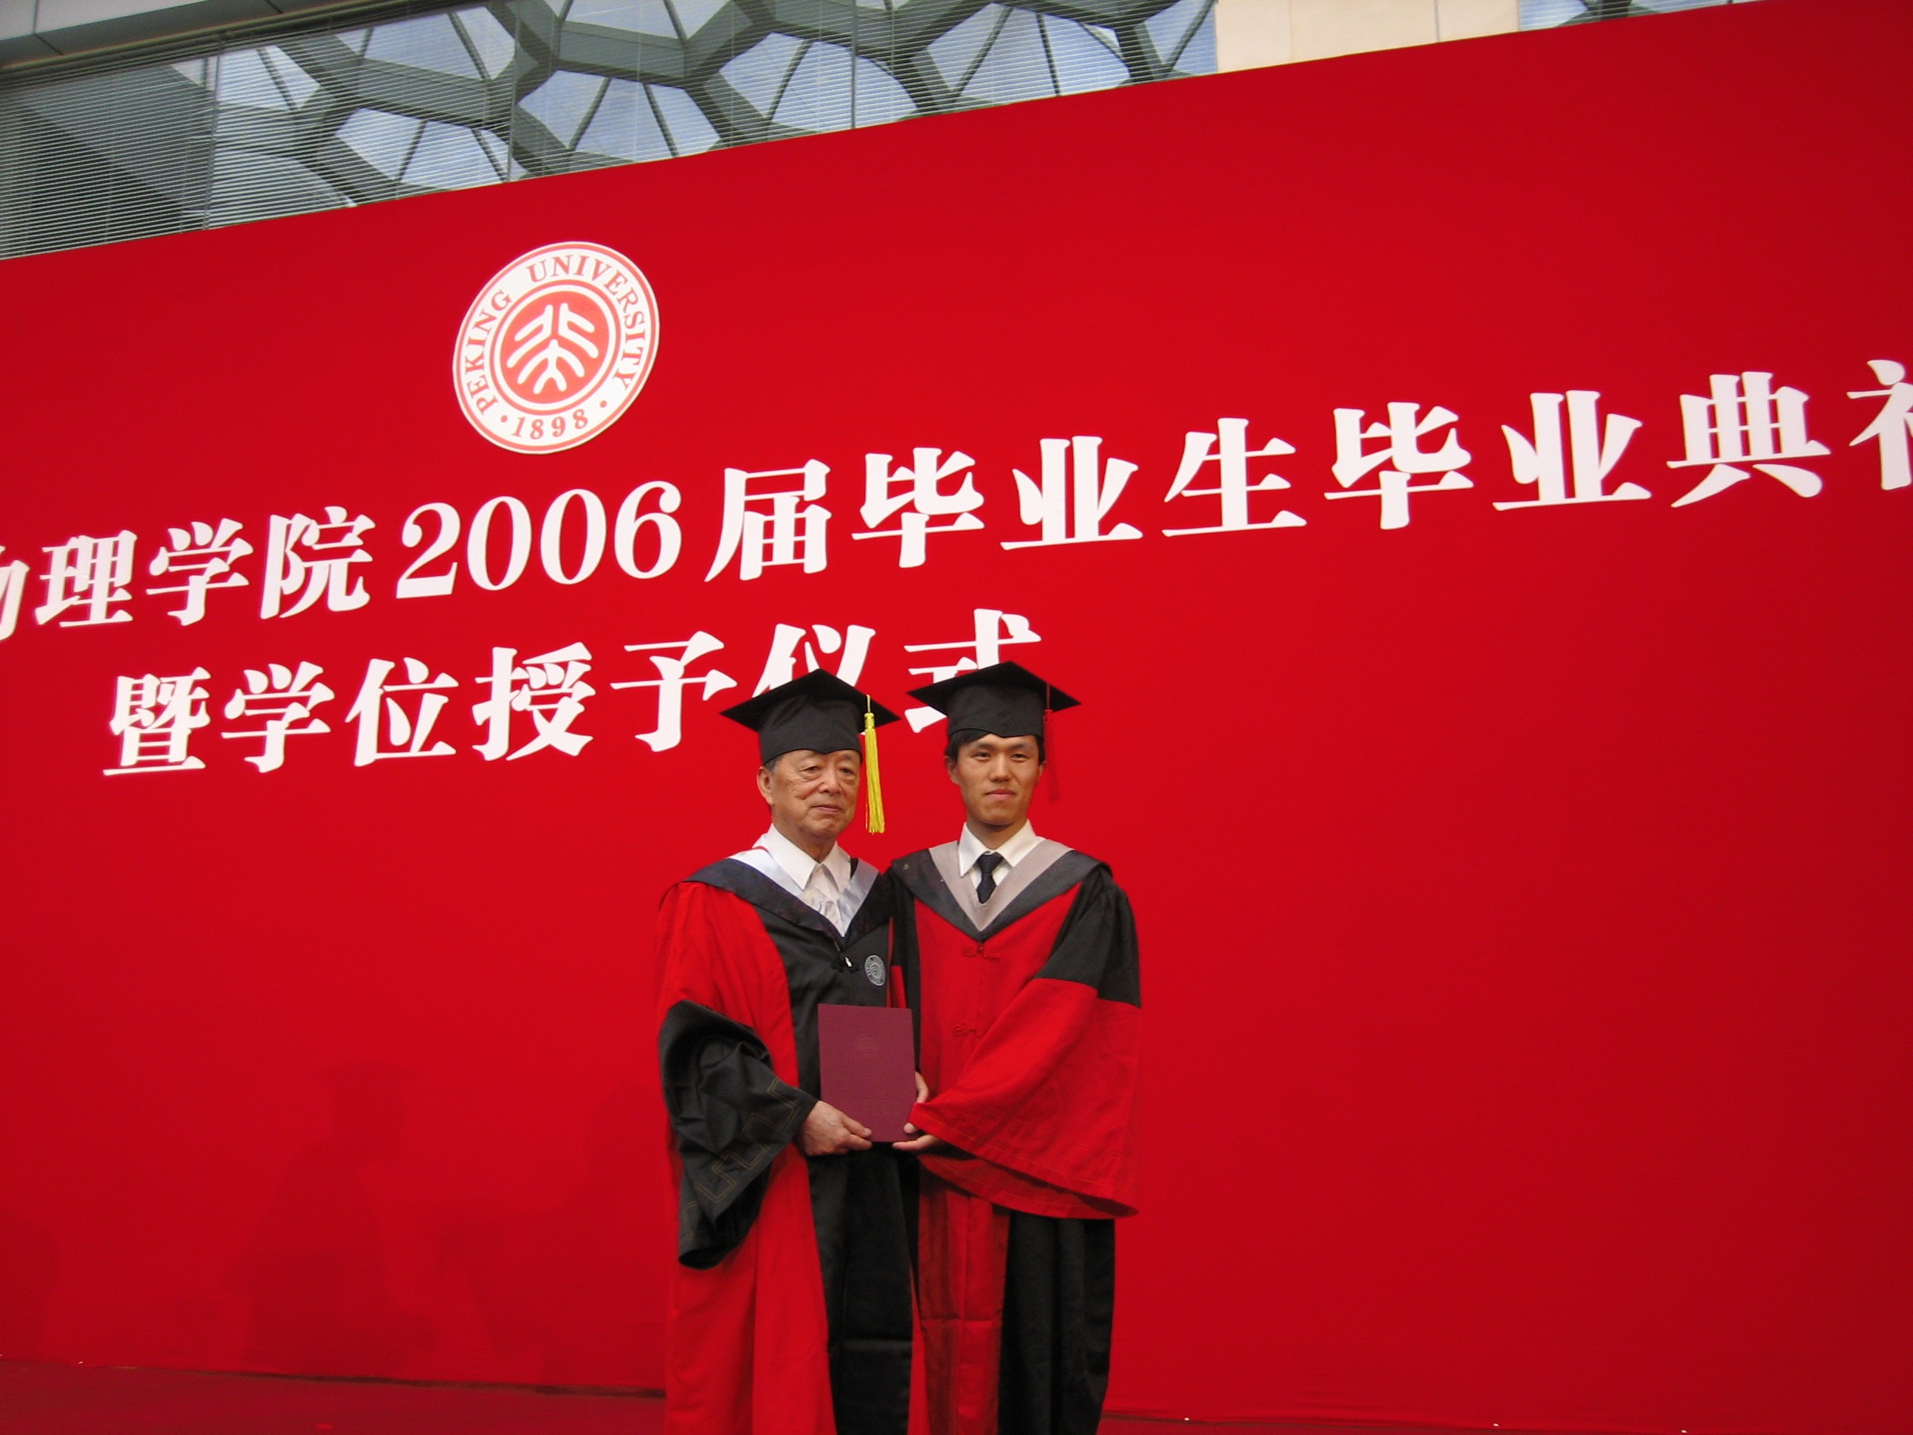

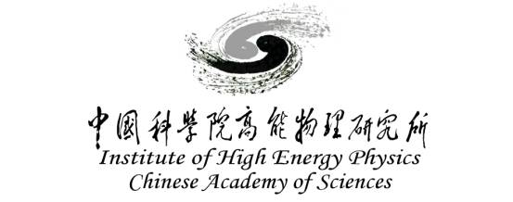







Peking University
Belle Experiment
KEK, JAPAN
Data Analysis
Software Development
Monte Carlo Simulation
Supervise Students
IHEP, CAS, BEIJING
Daya Bay Experiment
USC, U.S.
MINOS, NOMAD, NOvA, DUNE
Charlotte, NC

Slide 39
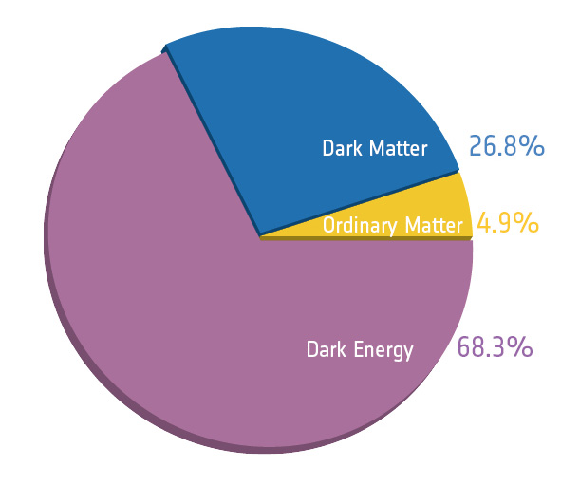
Relative amounts of different constituents of the universe
Look around you. Look into the sky – at night. Everything you see, the sun, the moon, distant galaxies, your body, your shoes, are all made of what we call ordinary matter^{[1]}. However it is only 4.9% of the universe.
[1] http://cosmology.berkeley.edu/Education/CosmologyEssays/ordinary.html
Notes:
While dark energy repels, dark matter attracts. And dark matter’s influence shows up even in individual galaxies, while dark energy acts only on the scale of the entire universe.

Slide 40
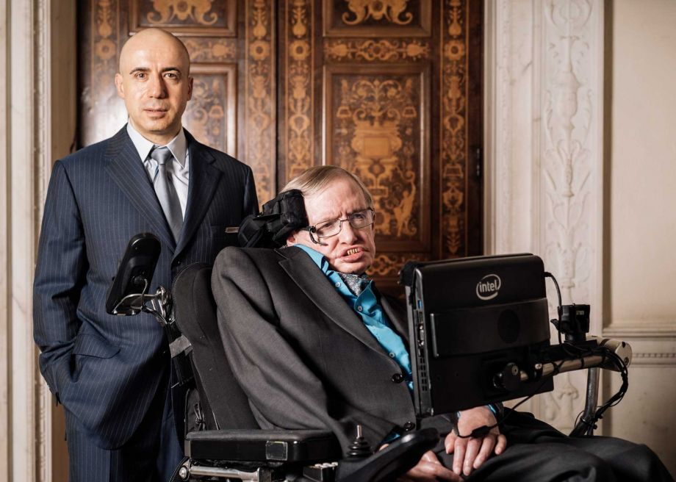
Breakthrough Listen
Thank you!

